Slide 1


(SCTP) Advanced Professional Certificate
Data Science and AI
Notes:
Welcome. Today we build a machine learning model that predicts HDB resale prices, compare three algorithms, and deploy the best one as a web app.

Slide 2
Agenda
Class Hands-on Activity : Predicting HDB Prices + Streamlit Deployment
Discord Questions
Project Discussion

Slide 3

C3.2 Predicting HDB Prices: 3 Models & Streamlit Deployment
Notes:
Module C3.1. Repo: https://github.com/flexfengfeng/6m-data-c3.2-HDB_price_predictor

Slide 4
Coaching Session 2 · Machine Learning & GenAI
C3.2
HDB Price Predictor
Comparing 3 Models
Linear Regression vs Random Forest vs Gradient Boosting, then deploy
Notes:
Learners fork the repo, work through the notebook, run model.py to train and pick the best model, then deploy app.py on Streamlit Community Cloud.

Slide 5
Today's roadmap
Goal: predict the resale price of an HDB flat, compare three models fairly, and deploy the best one as a web app.
1
2
3
4
5
6
Models
Linear Regression, Random Forest, Gradient Boosting
Metrics
MAE, RMSE and R²
Fair comparison
Train/test split and cross-validation
Features
Storey, one-hot encoding, Pipeline
Code-along
Notebook, model.py, app.py
Deploy
Streamlit Community Cloud
Notes:
Walk through the six stops. Emphasise that the point is not just to train one model, but to compare several fairly and justify which one we deploy.

Slide 6
Linear Regression
Linear Regression is used when you want to predict a continuous number (e.g., weight, price, temperature, salary).
Imagine you want to know if an HDB flat is priced fairly. Size matters, but so do location, floor level and the age of the lease.
Linear regression finds the best straight line through the data. With several features it learns one weight per feature: price = b₀ + b₁ × floor area + b₂ × storey + …
The Goal: find the weights that make predictions as close as possible to the real prices.
The Prediction: plug a new flat's features into the formula.
In our model, each extra sqm adds about S$3,800 and each extra storey about S$4,800. That easy-to-read output is linear regression's biggest strength.
Notes:
Coefficients come from the notebook, Part 5 (floor_area_sqm ≈ 3,771, storey ≈ 4,790). Ask: does an extra sqm really add the same dollars in every town?

Slide 7
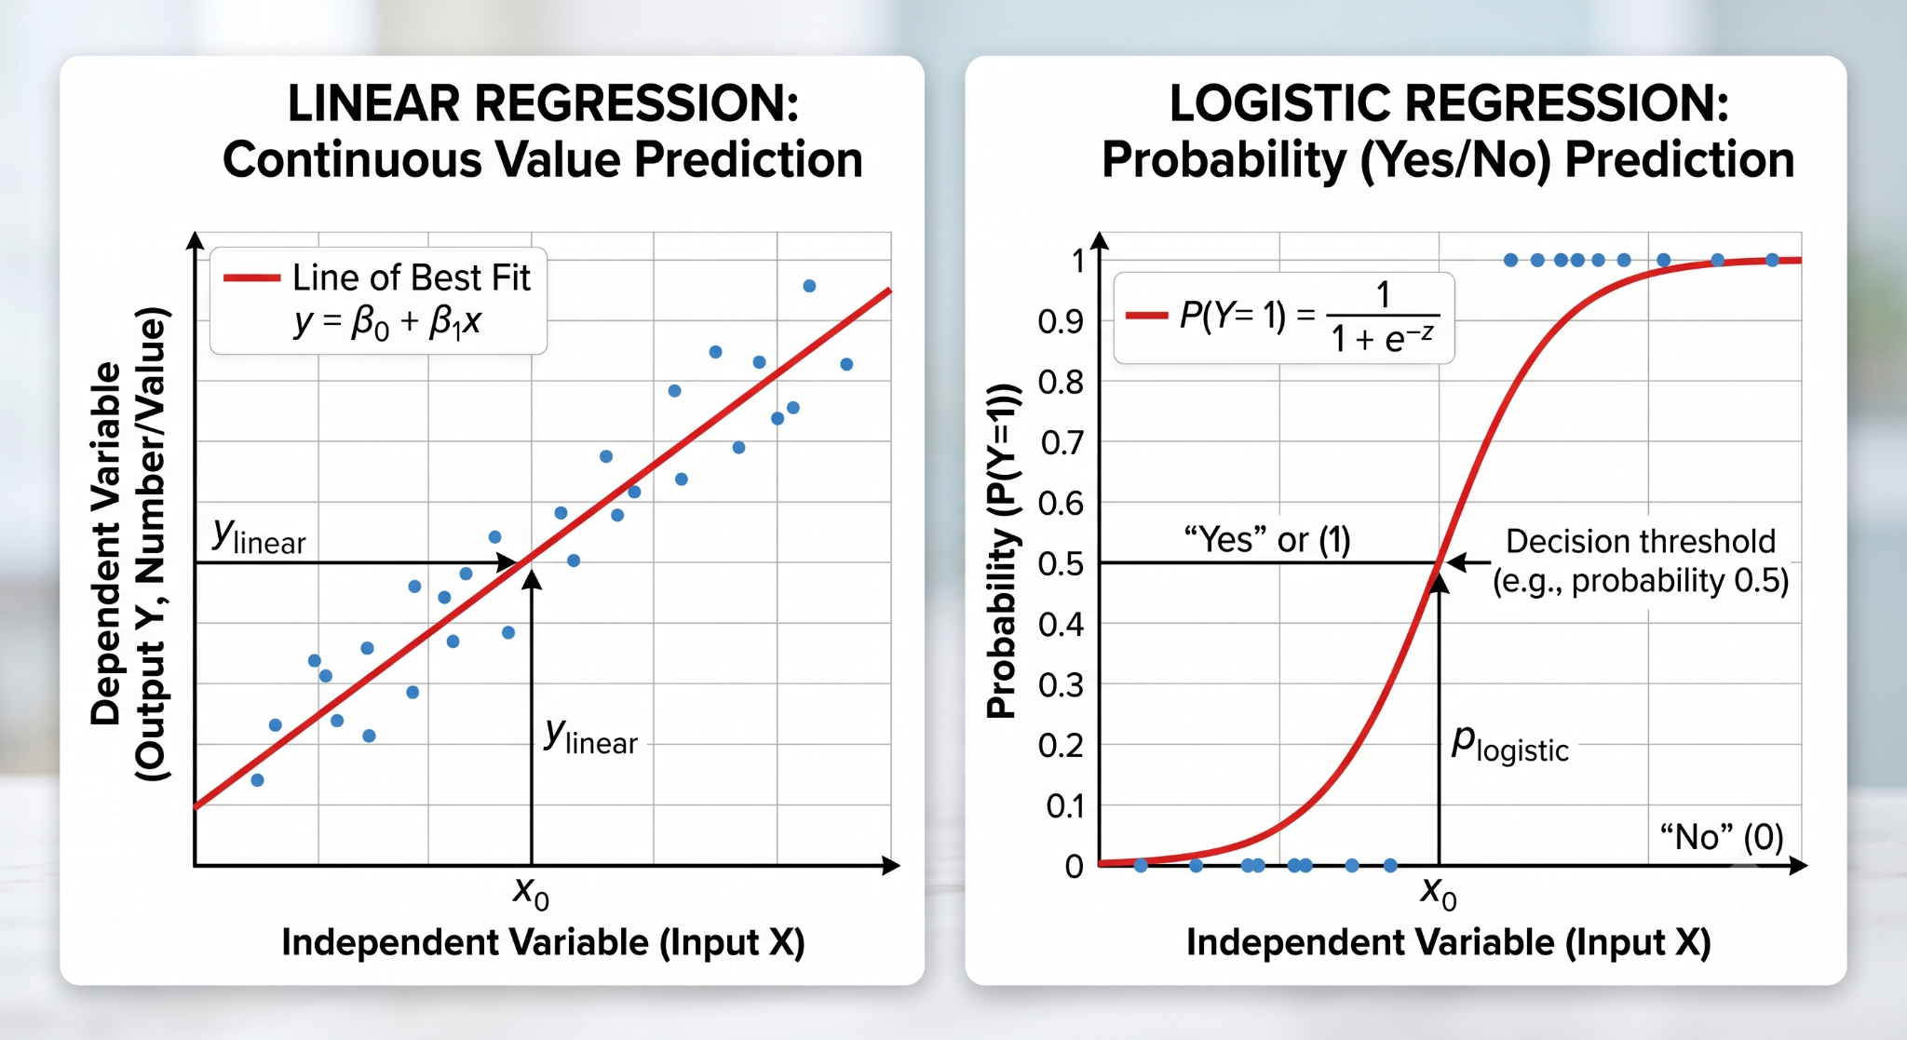
Linear vs Logistic regression
Notes:
Line of best fit: the model chooses b0 and b1 to minimise the squared vertical distances (errors) between the points and the line.

Slide 8
Difference : Linear vs Logistic regression
Feature | Linear Regression | Logistic Regression
What does it predict? | A specific, continuous value/number. | A probability that leads to a Yes/No category.
What does the line look like? | A straight line going up or down. | An S-shaped curve that flattens at 0 and 1.
Example | Predicting how many marks a student will score. | Predicting whether a student will Pass or Fail.
Notes:
Quick recap: regression predicts a number, classification predicts a category. HDB price is a number, so all three of today's models are regressors.

Slide 9
Beyond straight lines: decision trees
A decision tree predicts by asking yes/no questions about the flat, then returning the average price of similar flats in the training data.
Why we need it
Price does not rise in a straight line with lease year or storey, and an extra sqm is worth more in Bishan than in Woodlands. Trees capture these curves and interactions automatically.
The catch
One deep tree memorises the training data (overfitting). Combining many trees fixes this. That is exactly what Random Forest and Gradient Boosting do.
Floor area > 100 sqm?
No
Yes
Lease after 1995?
Central town?
No
Yes
No
Yes
S$330k
S$430k
S$560k
S$720k
Illustrative example: each leaf predicts the average price of the training flats that end up there.
Notes:
The tree on the right is illustrative, not our trained model. Point out how the second question depends on the first: that is an interaction a linear model cannot learn.

Slide 10
Three models, three ways to learn
 | Linear Regression | Random Forest | Gradient Boosting
How it learns | One weighted sum of the features | Many deep trees, each trained on a random sample of the data; their predictions are averaged | Many small trees built one after another; each new tree fixes the errors still left
Strengths | Fast, tiny file, easy to explain (S$ per unit) | Captures curves and interactions; needs little tuning | Often the most accurate on tabular data; compact file
Watch out for | Assumes straight-line, additive effects | Large file (stores every tree); slower to predict | Slower to train; more settings to tune
Settings in model.py | None to tune | n_estimators=100, min_samples_leaf=2 | n_estimators=500, max_depth=5, learning_rate=0.1
Notes:
Random Forest = many independent trees averaged (bagging). Gradient Boosting = trees built in sequence, each correcting the last (boosting). All three are wrapped in the same Pipeline.

Slide 11
How do we measure error?
Metric | What it tells you | Better when
MAE | Mean absolute error: the average size of a miss, in S$. Easy to explain: "off by about S$26k on average". | Lower
RMSE | Root mean squared error: squares each error first, so big misses count more. We use it to choose the model. | Lower
R² | Share of price variation the model explains. 1 = perfect, 0 = no better than guessing the average price. | Closer to 1
Always compare against a baseline. Predicting the average price for every flat gives R² = 0 and MAE ≈ S$119k. Any real model must beat that.
Notes:
Baseline numbers come from the DummyRegressor cell in the notebook (Part 4.4). RMSE is in the same units as price but punishes large errors, which matter for expensive flats.

Slide 12
A fair comparison: train/test split and cross-validation
1. Lock away a test set
80% of rows for training, 20% for testing (random_state=42). The test set stays untouched until the very end.
2. Cross-validate on the training set
Split the training data into 5 folds. Train on 4, score on the 5th, repeat 5 times and average the scores.
3. Choose, then test once
Pick the lowest cross-validated RMSE, then report its test score as the honest estimate.
Training data (80%)
Test (20%)
5-fold cross-validation on the training data
Fold 1
Fold 2
Fold 3
Fold 4
Fold 5
Train
Validate
Notes:
model.py uses KFold(n_splits=5, shuffle=True, random_state=42) and cross_validate. The test set is used exactly once, after the model is chosen.

Slide 13
Dataset: HDB resale prices
50,432
resale transactions
2017 – 2019
Jan 2017 to May 2019
26 towns
and 7 flat types
File: data/hdb_resale_2017_2019.csv, a copy of data.gov.sg resale data kept in the repo, so the lesson works offline.
Features: town · flat_type · floor_area_sqm · storey (from storey_range) · lease_commence_date
Target: resale_price (S$)
Not used: month (prices were fairly flat over this period), block and street_name (too many values), remaining_lease (repeats lease_commence_date).
Prices reflect the 2017 to 2019 market, not today's prices.
Notes:
Each row is one resale transaction. load_data() in hdb_features.py reads the local CSV and falls back to the original URL if the file is missing.

Slide 14
Preparing features: from raw columns to model inputs
Models need numbers. We convert text to numbers inside a scikit-learn Pipeline, so the app can pass in raw values such as "BISHAN".
storey_range becomes storey
"10 TO 12" becomes 11.0, the midpoint of the band.
One-hot encoding
Each town or flat type becomes its own 0/1 column.
Pipeline = encoder + model
Fitted on training data only (no leakage) and saved as one file.
hdb_features.py is shared
model.py and app.py import the same code, so features are built identically in training and in the app.
One-hot encoding of town
town | town_BEDOK | town_BISHAN | town_YISHUN
BISHAN | 0 | 1 | 0
YISHUN | 0 | 0 | 1
BEDOK | 1 | 0 | 0
The Pipeline
Raw columns
OneHotEncoder
Model
Notes:
Show hdb_features.py: storey_midpoint() and add_features(). In the notebook, Part 4.2 prints the 36 encoded column names. handle_unknown='ignore' stops the app crashing on an unseen category.

Slide 15
🟢 CODE-ALONG
Open: hdb_price_model.ipynb
What you'll do
1. Explore the data: price distribution, price by town, flat type and storey
2. Engineer features and build the one-hot encoding Pipeline
3. Train Linear Regression, Random Forest and Gradient Boosting
4. Compare them with 5-fold cross-validation, plus file size and speed
Select the hdb_project kernel first. A full run takes about 1 to 2 minutes; cross-validating the tree models is the slowest part.
Notes:
Setup: conda create --name hdb_project python=3.12, then pip install -r requirements-dev.txt. Pause at the discussion questions at the end of Part 8.

Slide 16
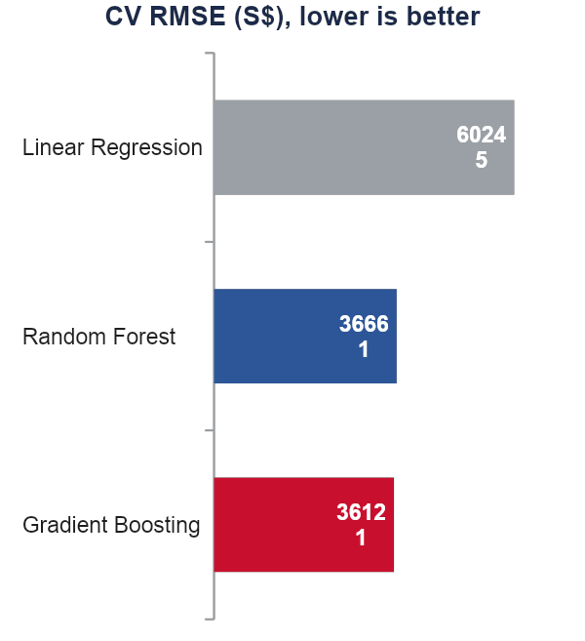
Results: which model wins?
Model | CV RMSE (S$) | Test R² | File size
Linear Regression | 60,245 | 0.848 | < 0.1 MB
Random Forest | 36,661 | 0.947 | ~26 MB
Gradient Boosting | 36,121 | 0.947 | ~0.7 MB
Tree models cut the error by about 40%
Price depends on the features in curved, interacting ways that a straight line cannot capture.
Features mattered even more
The original project used Linear Regression on 3 numeric columns only: R² ≈ 0.54. Adding town and flat type lifted it to 0.85.
Notes:
Numbers come straight from python model.py (also in README.md and models/model_card.json). Gradient Boosting is highlighted because it is the deployed model.

Slide 17
Choosing the model to deploy
Rule: deploy the model with the lowest cross-validated RMSE. That is Gradient Boosting (S$36,121).
Accuracy
Gradient Boosting and Random Forest tie on test R² (0.947). Gradient Boosting has the lower CV RMSE.
Size and speed
A 0.7 MB file is quick to push to GitHub and load in the app. The Random Forest is about 26 MB.
Plot twist
Random Forest has a slightly lower test MAE (S$25.1k vs S$26.2k). We still choose by CV, not by peeking at the test set.
When would you pick Linear Regression?
When you must explain every dollar to a stakeholder, or you have very little data.
35×
smaller file than the Random Forest (0.7 MB vs 26 MB)
± S$26k
typical error (test MAE), shown in the app as a price range
Notes:
Discussion: accuracy is only one criterion. For a web app, file size, prediction speed and explainability also matter. model.py applies the CV RMSE rule automatically.

Slide 18
🟢 CODE-ALONG
Open: model.py
What you'll do
1. Load the data and add the storey feature (from hdb_features.py)
2. Train all 3 Pipelines and score each with 5-fold cross-validation
3. Save the winner to models/hdb_price_model.joblib, plus models/model_card.json
requirements.txt pins exact versions (e.g. scikit-learn==1.9.1). The cloud must load the model with the same versions you trained with.
Notes:
Run: python model.py (about 1 minute). It prints the comparison table and the chosen model. model_card.json stores every model's scores plus the towns, flat types and ranges the app needs.

Slide 19
🟢 CODE-ALONG
Open: app.py
What you'll do
1. Load the saved model and model_card.json (cached with st.cache_resource)
2. Build the form: town and flat type dropdowns; sliders for size, storey and lease year
3. Make a one-row DataFrame with the same columns as training, then call model.predict
4. Show the price with a likely range, plus a Model comparison tab
Run: streamlit run app.py
Notes:
Key idea: column names and order must match training (FEATURES from hdb_features.py). The app opens at http://localhost:8501.

Slide 20
🟢 CODE-ALONG
Deploy the app
What you'll do
1. Commit and push your code and the models/ folder to your GitHub fork
2. Log in at share.streamlit.io with GitHub, then click Create app
3. Repository: your fork · Branch: main · Main file path: app.py
4. Advanced settings: Python 3.12 (same as you trained with), then Deploy
5. Share your unique URL. Full steps in setup.md
Notes:
Common failure: forgetting to push models/hdb_price_model.joblib and model_card.json. The app then shows 'No trained model found'. Troubleshooting table is in setup.md.

Slide 21
🧪 YOUR TURN
Exercises
What you'll do
1. Add flat_model as a feature. Does CV RMSE improve? What must change in app.py?
2. Shrink the Random Forest (n_estimators=50, min_samples_leaf=5). Accuracy vs file size?
3. Gradient Boosting with learning_rate=0.05 and n_estimators=1000: worth the extra time?
4. Retrain on the latest data from data.gov.sg. How much have prices changed since 2019?
5. Explain your app's accuracy to a non-technical user in two sentences.
Notes:
These match the exercises at the end of hdb_price_model.ipynb. Exercise 4 needs the month column as a feature, or training on recent months only.

Slide 22
Questions in Discord
Hi, I noticed that the lesson examples always select the best params based on the best score of GridSearchCV and RandomisedSearchCV. Is it always safe to select the params based on the best score? What if the best score is overfit? (Chean Wei)

Slide 23
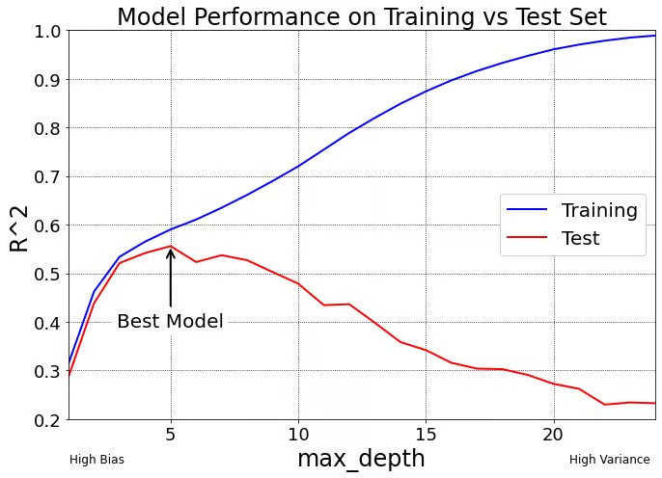

Slide 24
Hi, Bagging and Boosting are two different ensemble methods.
Could I understand stacking as another branch under ensemble learning and how it’s work in prediction?
Would stacking therefore be considered a form of hybrid machine learning?
(Yoke)

Slide 25
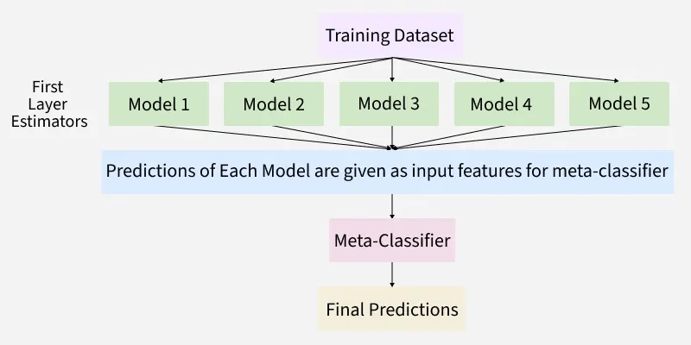

Slide 26
3. If combine model such as random forest , xgboost etc using stacking, is the main objective to see whether their combined strength can outperform the best standalone model on unseen data? If stacking model performs worse than the best standalone model, is it acceptable to conclude that the standalone model more suitable for that dataset? Thanks

Slide 27
I saw in lesson 3.3 that slide 18 mentioned about regularization for Logistic regression. A bit was mentioned on Thursday lesson. Will this be covered more on Sat so that we know how to use it to resolve overfitting? (Boon Wee)

Slide 28
bias → underfitting; too simple
boosting
change kernel
variance → overfitting
bagging
learning rate
regularisation
lasso, ridge regression (feature selection, weight reduction)
adding more features (columns)
adding more data (rows)

Slide 29
